Slide 1
DIJKSTRA’S IMPLEMENTATION IN UBER (Greedy Algorithm)

Slide 2
UBER
The Uber application is a user-friendly mobile platform that revolutionizes urban mobility and enhances convenience for millions worldwide. Through the app, users can seamlessly request rides with just a few taps, accessing a diverse range of transportation options tailored to their needs and preferences. It finds the closest driver considering your preferences, and uses real-time traffic data to suggest the fastest route for your driver.

Slide 3
Algorithms we use in mimicking Uber
Uber uses several algorithms which are not disclosed and here’s our analysis on what might be the possible one :
Dijkstra's Algorithm
This algorithm might play crucial role in optimizing various aspects of Uber's operations, ranging from route planning to filtering available drivers. Let's delve into algorithm's functionality and its significance in Uber's ecosystem.

Slide 4
Dijkstra's Algorithm
Dijkstra's algorithm is a famous algorithm for finding the shortest paths between nodes in a weighted graph.
1. Initialization: The algorithm starts at a chosen source node (like your starting point on the map). It keeps track of two things for each node: distance from the source node (initially infinity for all except the source node itself, which is 0) and a visited flag.
2. Iteration: It picks the unvisited node with the smallest distance estimate from the source node. This is like exploring the most promising path first based on current information.
3. Relaxation: The algorithm then checks all the unvisited neighbors of the picked node. For each neighbor, it calculates the distance through the current node. If this distance is smaller than the neighbor's current distance estimate, the estimate is updated. This process is called relaxation, like revising your route if you find a shortcut.
4. Repeat: Steps 2 and 3 are repeated until all nodes are visited. By the end, each node has the shortest distance from the source node.

Slide 5
Dijkstra’s implementation in Uber
1. Setting Up the Graph:
- Imagine a simplified city map with roads as edges and pick-up/drop-off points as nodes.
- Each edge is assigned a weight representing distance or estimated travel time.
2. Rider Requests a Ride:
- User enters their pick-up and destination points.
3. Finding Available Drivers:
- The system identifies potential drivers currently logged in and available.

Slide 6
4. Dijkstra’s Approach:
- For each available driver, the system temporarily treats their location as the starting point (source node) in the graph.
- Considering the pick-up point as an intermediate node and the rider's destination as the final node.
- The algorithm calculates the total weighted distance (or time) for the driver to reach the rider and then to the destination.
5. Selecting the Best Driver:
- The system compares the total distances/times calculated for each driver using Dijkstra's algorithm.
- The driver with the shortest overall route (considering reaching the rider and then the destination) is chosen.

Slide 7
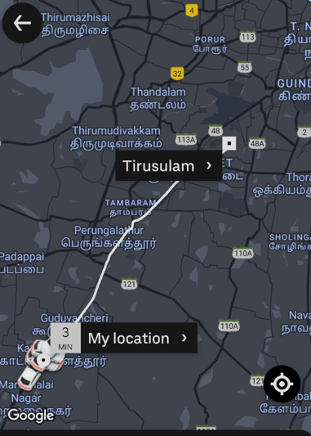

Slide 8
Example
2.1 km
(source)
23 km
Pammal
SRM
5.2 km
Tirusulam
15 km
7.9 km
( destination)
Tambaram
Pallavaram
3.1 km
7.7 km
Minimum distance : 15 + 7.7 + 3.1 = 25.8 km

Slide 9
Pseudocode
function Dijkstra(Graph, source):
for each vertex v in Graph.Vertices:
dist[v] ← INFINITY
prev[v] ← UNDEFINED
add v to Q
dist[source] ← 0
while Q is not empty:
u ← vertex in Q with min dist[u]
remove u from Q
for each neighbor v of u still in Q:
alt ← dist[u] + Graph.Edges(u, v)
if alt < dist[v]:
dist[v] ← alt
prev[v] ← u
return dist[], prev[]

Slide 10
Time Complexity
Best Case: The best-case scenario occurs when the algorithm efficiently finds the shortest paths without having to explore unnecessary vertices and edges. This typically happens when the graph is very sparse, with relatively few edges compared to the number of vertices.
Time Complexity : O(V)
Average Case : Time complexity of Dijkstra's algorithm is closer to O(V) for sparse graphs and closer to O(V^2) for dense graphs, where V is the number of vertices.
Worst Case: The worst-case time complexity occurs when we select the vertex with the maximum distance greedily.
Time Complexity : O(V^2)

Slide 11
Contribution
Presentation Compilation:
Problem Simulation:
Project Ideation and Analysis:
Shreyanshi Sharma (RA2211028010090)
Kartik Jhanwar (RA2211028010076)
Siddharth Singh (RA2211028010074)

Slide 12
Thank You

